Slide 1
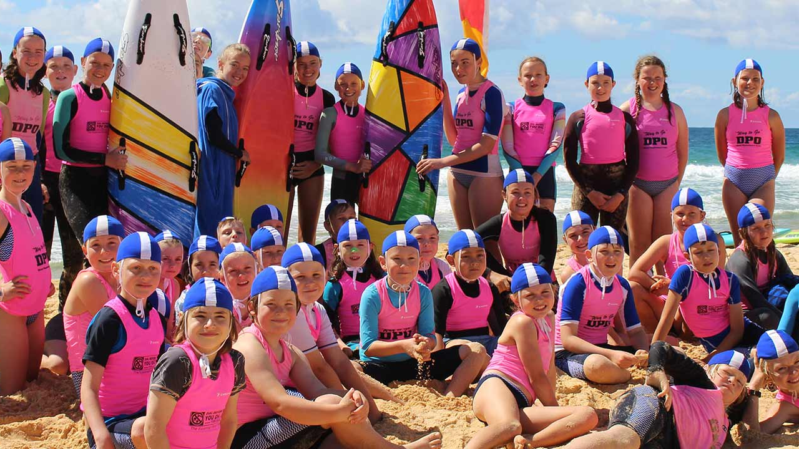

XXX Club Junior Activities Pre-Season Team Briefing
0

Slide 2
Guidance Notes - Instructions
Yellow Boxes with Red Writing are slides that are suggested to be tailored to your specific club requirements. They will include suggested content material to use but are not finalised
Green boxes with white writing are slides that are ready to use and do not require editing unless you choose to edit or remove.

Slide 3
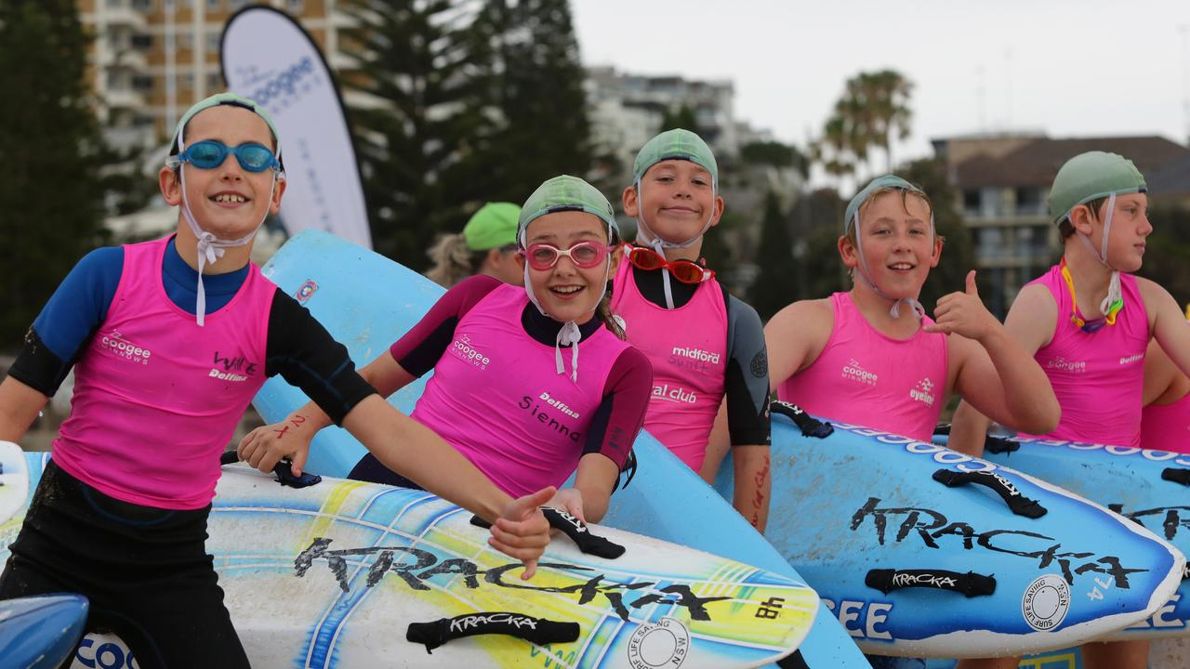
Overview
This is a suggested content structure, clubs are welcome to tailor to their own requirements
  Program:
  Last Season Overview
  Nippers Team for 2025-26
  What are we here for? Club Culture and Outcomes
  Program Delivery
  Growing our Nippers
  Parent Engagement
  Upskilling our Nipper Team
  Come & Try and Junior Search & Rescue
  Resources for everyone
  Branch-Specific Information
Notes:
It is intended that information be tailored to the branch as required.
The aim of this information pack is to provide Junior Activity Chairs and their Management Teams with the skills, knowledge, experience and understanding to enable effective and efficient management in the safe running of Junior Activities at a Surf Life Saving Club.

Slide 4
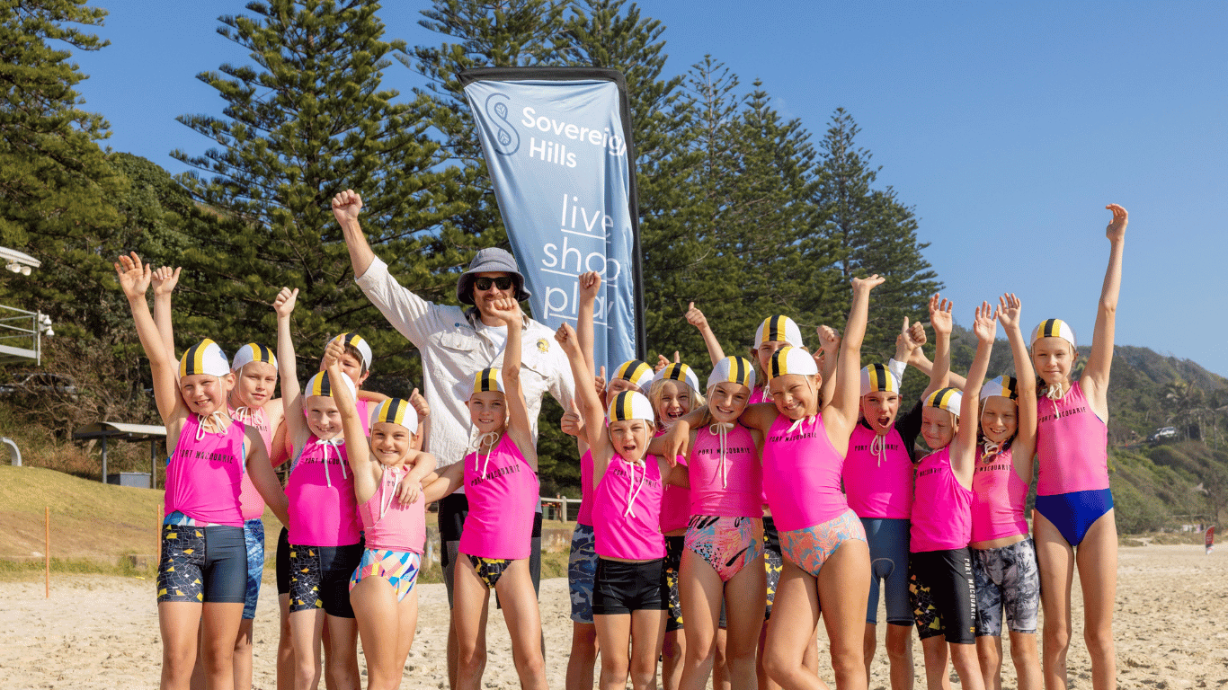

We suggest starting your session with a review of last season (what worked well what didn't) and key focus areas for your team for the season ahead
Nippers Season 2025-26
What worked during the 2024-25 season?
What are we planning to do to better this season?
Open discussion and input from the team with feedback
  Upskilling for the Team
  Everyone is a proficient Age Manager
  First AID certificate / Radio / ART
  Introduction to Patrolling Award
  SRC or BM
  SLS Leadership Online Courses

Slide 5
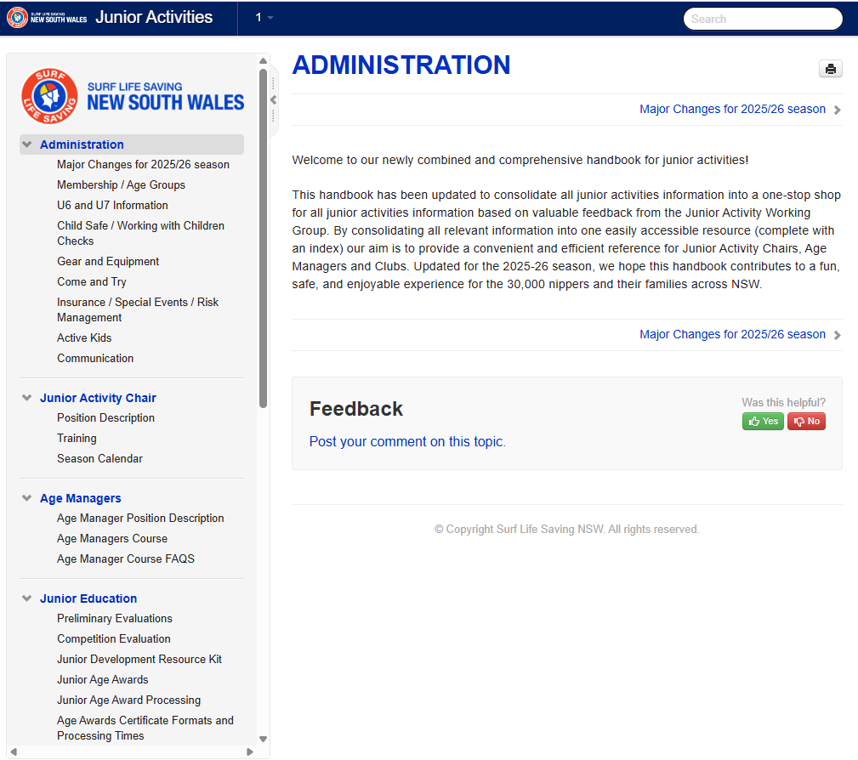
Slide ready to go – provides an overview of the new JA handbook
Junior Activity Handbook 2025/26 Season
All information and resources have been moved into Manula which is an online handbook
Key changes will be outlined at the front, and all other information relating to Junior Activities will be available in this searchable document.
New information here includes communication platforms, special events and risk management, Nipper Safety Assistant roles
https://www.manula.com/manuals/slsnsw/junior-activities/1/en/topic/administration
Notes:
https://www.manula.com/manuals/slsnsw/junior-activities/1/en/topic/administration

Slide 6
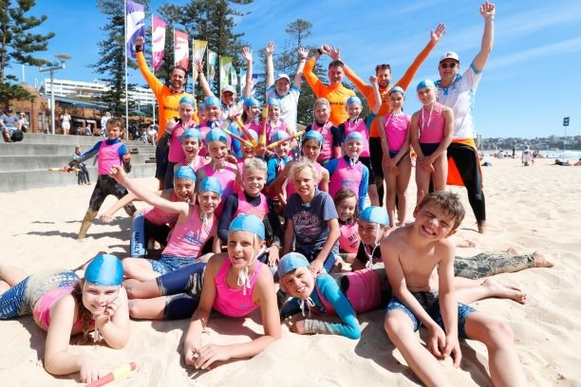
Run through your team – not everyone will be familiar with who is doing what. Maybe provide an overview of each roles and responsibilities. For Smaller Clubs – Feel free to reduce this to key points of contact.
Nippers Season 2025-26
Who is our team?
  JAC / Deputy
  Nipper Committee
  Water Safety Supervisor
  Age Managers
  Education Rep
  Admin/Support
  Youth Engagement
The Roles and Responsibilities.
NOTE: For Smaller Clubs – feel free to reduce this to key points of contact.

Slide 7
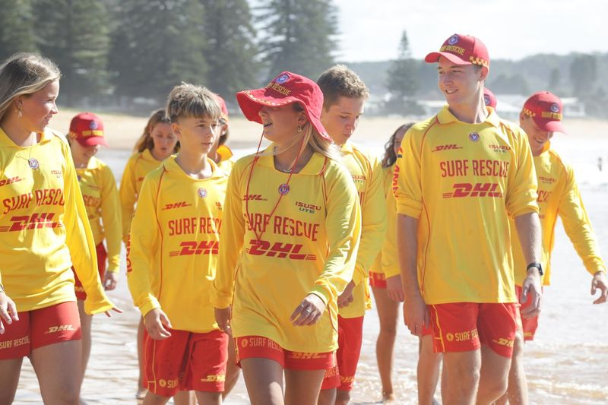
OPTIONAL - Slide ready to go – work with your team to determine the purpose of nippers and set the tone
Why do we have Nippers?
Notes:
Slide Aim: Lifesaving in action. An example of the skills juniors will learn and one day can use to save lives.
BRAINSTORM WITH TEAM
Heritage
Surf aware
Community
Leadership
Board Rescue
Safe
Board Paddling
Enthusiasm
Friendship
CPR and Defib
Tube rescue
Teamwork
Courage
Fun
Camaraderie
Surf Swimming
Radios
Fitness
Resilience
The aim of Nippers is to train young people to become lifesavers and be active and engaged members of patrol while serving their local communities, many Nippers around Australia rescue people all the time. If we weren’t there and we didn’t have the skills and teamwork we have, then many people would not come home form the beach.
Story/Example: (opportunity to personalise it to your club/branch)
Story 1. U11-U12 Nipper knows how to paddle a board. Comes across a patient in serious distress in the water. Tries to get them on the board, falls off, and finally brings them in -people arrive and they don't know CPR either and someone calls the Ambo?
Story 2. U11-U12 Nipper knows how to paddle a board, board rescue and CPR. Comes across a patient in serious distress in the water. Gets them on the board via knowledge ad skills, catches a white wave and brings them in. Commences CPR, then people arrive, the Nippers tells them how to do CPR and someone call the Ambo.
Which outcome do we want?

Slide 8
Provide an overview of your nipper program – some suggested content below. Notes: For Smaller clubs feel free to specify you inclusive program and not talk to the age requirements
Nippers Season 2025-26
What are we here for?
One Club and One Culture Discuss (ensuring everyone is on the same page)
What is our main messaging to our Nippers/Parents?
What and who do we celebrate?
Do all the parents know why we are here?
What are our communication procedures / mechanisms?
Reinforce the key messaging around nippers is about fun, skill, safety and long-term friendships – talk about the program – weekly/monthly etc
Tailored learning journey for each age group/nippers developing ocean skills, teamwork, SLS Skills, opportunity.
A program that is inclusive and delivers for everyone
A program that is delivered by skilled and qualified members
A program that is not just about surf sports
Notes:
Member of Club Exec to attend to show support and one Club approach

Slide 9

Age Guides
Slide ready to go – Overview of Age Guides
The Age Guides are updated to reflect the most up to date teaching techniques, rules and relevance and lesson plans have been redesigned to ensure ease of use and interaction. They includes lessons and resources that are tailored to each different age group.
The program covers a diverse range of skills from body surfing to catching waves on a board to First Aid, CPR and the surf environment.
Notes:
Note: It is not an assessment which if not completed competently precludes the child from becoming a member or continuing with junior surf education or training activities. Any child that does not meet the required evaluation level will require a higher level of supervision when involved in water-based activities at the discretion of the club. Refer to SLSA Water Safety Procedure 1.01a.
The program is based on participatory evaluation and not assessed on competence; this means children must only be actively involved in each of the lessons to be eligible for their relevant Surf Education award. The program provides a pathway of learning towards the Surf Rescue Certificate, which members can begin training towards from the age of 13.
Information on who can assess preliminary skills, and how to conduct the evaluation is found in the AGE GROUPS, PRELIMINARY AND COMPETITIONS EVALUATIONS FACTSHEET

Slide 10
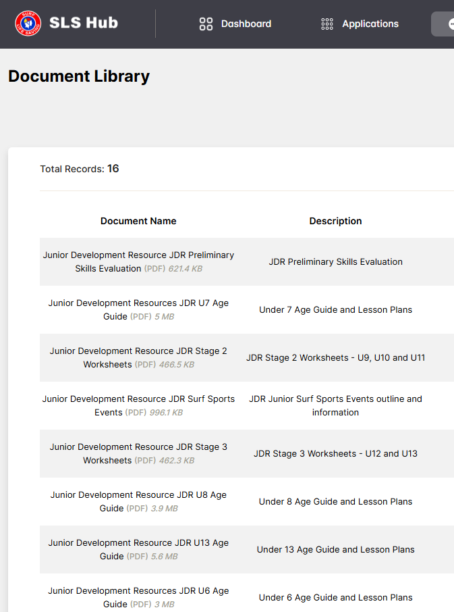
Junior Development Resource Kit
Slide ready to go – Overview of Junior Development Resource Kit
The national Junior Development Program includes lessons and resources that are tailored to each different age group. The program covers a diverse range of skills and is based on participatory evaluation.
The program provides a pathway of learning towards the Surf Rescue Certificate and creating future lifesavers.
Available on the SLSNSW Website / SLS Hub. Supported by ‘Age Groups, Preliminary and Competitions Factsheet’.
Notes:
Slide Aim: Outline the JDR kit and how valuable it is as an education resource for all age groups.
- The JDR is a valuable education resource available for Age Managers covering all aspects of lifesaving and development both in skill development and surf education
- The JDR is a great resource, easy to read, simple to follow and extremely beneficial for new Age Managers. Easy to prepare for Age Managers prior to arriving at Nippers.
- By utilizing the JDR you are ensuring you cover all aspects of the SLS Surf Education Award curriculum from U6 right through to your SRC’s
- Parents will see a more professional presentation and structured program each week whilst developing a greater understanding of what the Junior Activities program is all about.
This in turn provides opportunities for further involvement with parents encouraging them to support us in delivering our lifesavers of the future.
- Make sure your club knows Nippers still goes ahead on rainy days, and don’t leave surf ed to only rainy days! This may discourage nippers from participating if they expect rainy days to mean surf ed only.
Example / Suggestion: Create cheat sheets with Waterproof paper

Slide 11
Major Updates for 2025-26
Largely ready to go – can be updated to include any club specific changes
The SLSA Age Manager Course has a refreshed look and improved content (no requirement for existing Age Managers to complete this course)
Proof of age (eg birth certificates) is no longer required for new members joining Nippers
A Nipper Safety Assistant (NSA) Award has been created to assist Clubs with additional resources for Water Safety during Nippers.
Sub membership-categories now include Nipper Parent and Inclusive / Adaptive Program Participant
Please refer to the SLSNSW Junior Activity Handbook for more information.

Slide 12
Nipper Safety Assistant Award
Slide ready to go – Overview NSA
A new Nipper Safety Assistant (NSA) Award has been created nationally to assist clubs with additional resources for water safety during Nippers. NSAs can support water safety personnel during Nipper activities when it has been deemed suitable by the Water Safety Supervisor and when:
Conditions are confirmed as low risk conditions with an assessment completed in the Surf Risk Rating (SRR) tool.
The age group is U8 or below.
Activities are shallow water only.
NSAs do not make up more than 50% of the water safety team for the Nipper activity.
The award is available for members aged 13+ and requires completion of a 50m swim, 2-minutes of treading water, signals and rescue tube orientation and practice in its usage.
Please refer to the SLSNSW Junior Activity Information Handbook for more information.
Notes:
The NSA Award can be delivered by SRC/BM TAFs or Endorsed Delegates using just the Signals Poster and NSA Sign Off Sheet from the SLS Document Library. Clubs are encouraged to grow their pool of Endorsed Delegates to reduce reliance on existing TAFs – see Policies 1.01A and 1.01B for details (can be found in SLS Hub).
Policy 1.01A Water Safety Procedure
Policy 1.01B Nipper Safety Assistant Award Procedure

Slide 13
Junior Activity Training 2025-26
OPTIONAL - Slide ready to go
Pre-Season JAC Training
Tue 23 Sept, 7-8pm
For new & returning JACs + teams
Updated resources, key season changes, Q&A
Registration link here
Mid-Season Check-In
Mon 8 Dec, 7-8pm
Reflect on season, share tips & strategies
Nipper engagement, parent involvement, membership
Registration link here
Virtual Age Manager Course
Wed 15 Oct, 7-8.30pm
Covers roles, communication, planning, safety
Registration link here
Notes:
Junior Activity Chair Training
The aim of this training is to provide Junior Activity Chairs and their Management Teams with the skills, knowledge, experience and understanding to enable effective and efficient management in the safe running of Junior Activities at a Surf Life Saving Club.
This is formal training and has been created to ensure it has practical and defined outcomes for Junior Chairs and their management teams. Managing and running Nippers is not a one-person job, hence this course is aimed at all members involved in the running of nippers.
On completion of the zoom training, Branches will be advised of the newly trained members and SLSNSW will allocate the Junior Activity Management Course Award to their SurfGuard record.
RESOURCE – JAC Course Factsheet on SLSNSW website
Registration links:
Introductory JAC Training - https://slsnsw.zoom.us/meeting/register/25WxCJvZSyWjH1FZL4SQlg
Pre-Season JAC Training - https://slsnsw.zoom.us/meeting/register/ZWIhj0ZhQP-ciA-rG0sHQg
Virtual Age Manager Course - https://slsnsw.zoom.us/meeting/register/Hacr2u4ZTxKY55zv6_t5xg
Mid-Season Check-In - https://slsnsw.zoom.us/meeting/register/oiydmqcGRf6s5dq5wkgteg

Slide 14
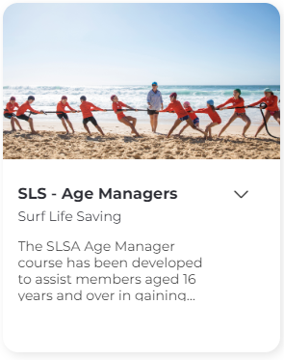
Slide ready to go – Overview of Age Managers Award
SLSA Age Manager Award
There is an online course for Age Managers
Can be viewed as a group at a pre-season meeting and a bulk proficiency processed
Your Age Manager award will be updated in SurfGuard once this is complete
An important component of the course is the practical session on the beach which is organised by Club JAC’s.
Age Managers no longer need to complete assessment paperwork
The Age Manager : Nipper ratio in NSW is 1:20 for on land activities

Slide 15
Age Managers Course
Slide ready to go – Overview of Age Managers Course and Requirements for 202526
New Age Managers MUST complete:
Child Safe Awareness training
Online Theory Course – Face to Face or Online
Returning Age Managers must complete
- Age Manager Proficiency Video (2025/26 Update)
Age Managers who have not been active for 5 years or more will need to complete the full course
This is outlined in the Junior Activity Handbook
Notes:
MAJOR Update – Introduction of Age Manager Proficiency Video (mandatory)
Emphasis on pre-requisites of completing Child Safe Awareness Training and Age Manager Course to access the Proficiency Video.
The Child Safe Awareness cannot be completed in a group format. SLSNSW do not approve of this, as there is a lot of content to be covered, along with questions and check ins along the way. There is also a reflection section at the end of the training which needs to be completed individually.

Slide 16
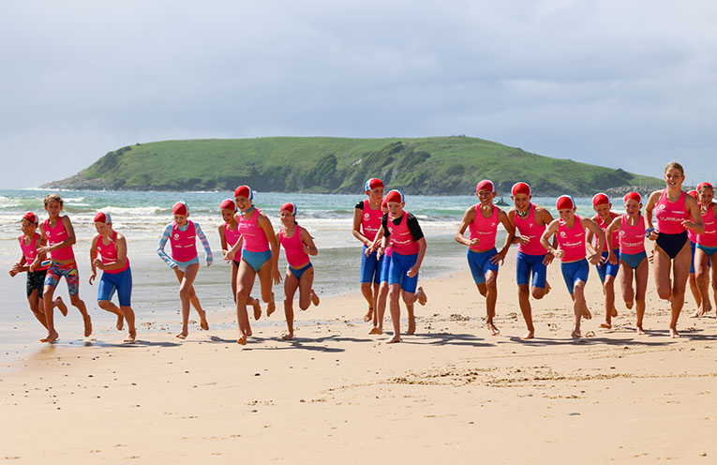
Growing Our Nippers
Growing your nippers – this slide is about growth and retention and can focus on your specific club requirements. Some suggested content included
A focus on retaining our Nippers as they get older
Why do our Nippers stay in the program and why not?
For discussion
A focus on the goal of becoming a Surf Life Saver
Everyone can achieve this
What resources do we need to change up the growth?
Talk about where you have tailored any times for different age groups – shorter times for younger age groups.
Notes:
A Focus on retaining our Nippers as they get older
(Reference the last seasons data and see the change out in theage groups and ask why?..and can your team change this ?)

Slide 17
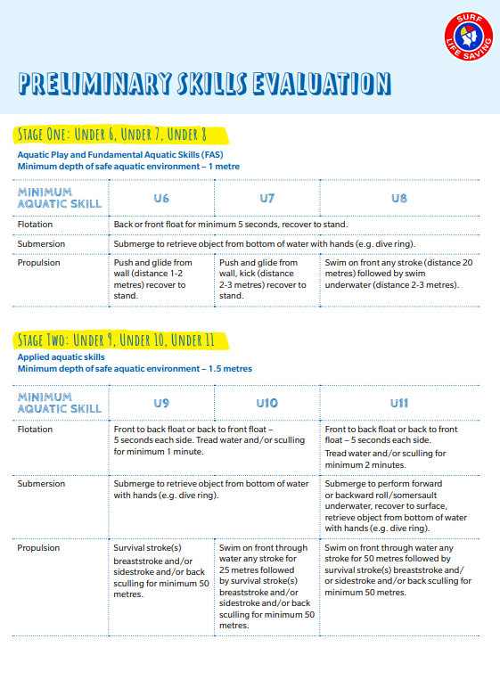
Preliminary Skills Evaluation
Slide ready to go – Preliminary Skills Evaluation Update
The Junior Preliminary Skills reflect industry standard research in aquatic skills, including greater focus on foundation skills in the water which assist in making rescue ready lifesavers.
In instances where evaluations cannot be completed by a Surf Life Saving member and to increase flexibility for clubs, a qualified and accredited swim coach can complete the evaluation by providing their ASTCA number and details.
Notes:
Note: It is not an assessment which if not completed competently precludes the child from becoming a member or continuing with junior surf education or training activities. Any child that does not meet the required evaluation level will require a higher level of supervision when involved in water-based activities at the discretion of the club. Refer to SLSA Water Safety Procedure 1.01a.
All new junior members should be supported by a 1:1 water safety ratio (water safety personnel: activity participant) when completing the evaluation. For all junior members returning from the previous season where a knowledge of their ability is known by the club, a 1:5 water safety ratio (water safety personnel: activity participants) may be used (refer to SLSA Water Safety Procedure 1.01a).
Information on who can assess preliminary skills, and how to conduct the evaluation is found in the AGE GROUPS, PRELIMINARY AND COMPETITIONS EVALUATIONS FACTSHEET
Swimming coaches are required to provide their Australian Swimming Teachers and Coaches Associate (ASTCA) number, their name and email address and the name of the children who have successfully completed the evaluation.

Slide 18
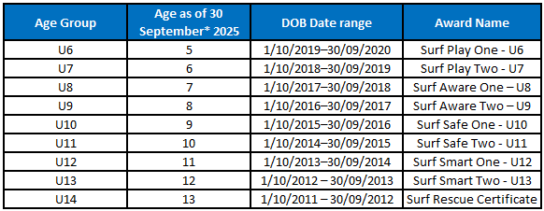
Junior Age Awards
Slide ready to go – Junior Age Awards
It is recommended that nippers who complete 50% of nipper sessions (recorded in nipper attendance sheets or via the app) are eligible for the award and included in the award assessment request.
Award processing is done via a New Assessment Request in SurfGuard for each Award. Clubs must check that children are entered into the correct Award Assessment Request for their age group, and this may require clubs to check dates of birth.
More information on award processing is in the Junior Activity Handbook
Notes:
Stage 1 – U6, U7 and U8
Stage 2 – U9, U10 and U11
Stage 3 – U12, U13 and U14

Slide 19
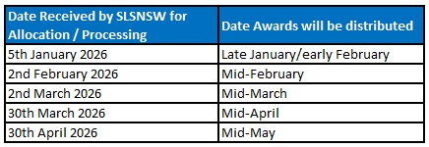
Junior Education Awards Dates
Junior Surf Sport competitors (U/8-U/13) are no longer required to have the relevant Age Award prior to 31 December to compete in Championship events.
The Age Awards remain a key educational component of Junior Activities and this change enables clubs to deliver surf education to members throughout the season.
U/14 members are still required to obtain their SRC for championship events as per the Surf Sports Manual.
To streamline administrative processes and
ease pressure on clubs, SLSNSW has extended
the cutoff date for Age Award Processing.

Slide 20
Nipper Parent Engagement
Nipper Parent Engagement – this slide is about how you engage with your parents. Provide and overview of the roles and mechanisms for engagement – suggested content included

Slide 21
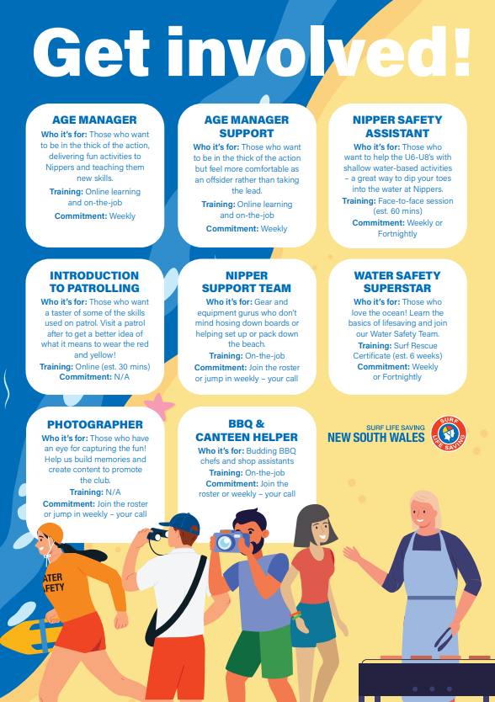

Nipper Parent Engagement
www.surflifesaving.com.au/members/members-info/nipper-parent-information/
Notes:
Please take through each step and highlight that supporting resources are available
Need to enhance the comms with the Parents
This Season: Online Parents information session x 2 - one for new and one for returning
Provide engagement opportunities -
Overview of the different roles
Talk about the different training options - even during Nippers while there
Talk about your engagement platforms
Overview of events
Talk about the culture and values
Visit the SLSNSW Website for Engagement ideas

Slide 22
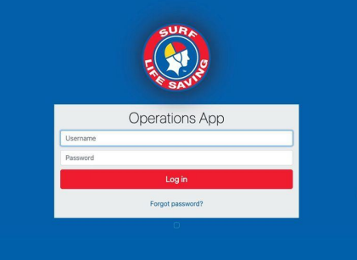
Slide ready to go – Surf Risk Rating
Surf Risk Rating
Ensure that the Surf Risk Rating App is completed by the appropriate personnel, i.e. Water Safety Supervisor or similar before any Nippers session is conducted on the beach. Remember that it should be used prior to any other out-of-regular ‘Nipper time’ training sessions eg all ocean based oaching sessions
A Surf Risk Rating:
Is a reflection of the most hazardous observations of the surf characteristics
Is measured over a given time period (approx. 20 – 30 minutes)
Is measured ON the beach

Slide 23
Nipper App / SurfGuard Nippers Module
Slide ready to go – SurfGuard overview
The Nipper ‘App’ is a platform introduced by SLSA, accessible via Members Area.
Junior Activity Chairs can:
Access a newly assigned permission area in SurfGuard - Nippers module
Manage and assign Age Manager access to the Nipper App
Age Managers can access one or multiple age groups and access levels (below
Age Managers can:
Manage Nipper Age Groups – check in, check out, add notes, view nipper details
View sessions attended and approve Nipper Age Group Awards and
Approve preliminary and/or competition skills evaluations
Nippers can view sessions attended and awards gained via Members Area.
SLSA Nipper Module Overview
An overview of the Nipper module functions in Surfguard & SLS Hub
https://help.sls.com.au/webinars/

Slide 24
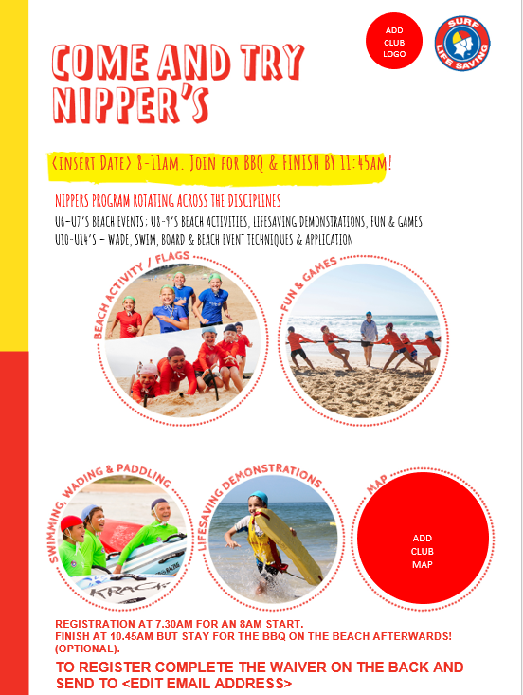
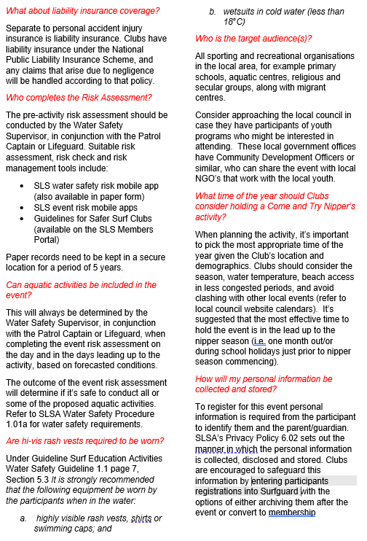
Come & Try
Optional Slide – tailor to your specific needs as a club
Clubs can offer come and try activities this season.
A Supporting Guide for Clubs and a Come and Try Flyer (with a sign-up form and mandatory SLSA waiver) have been created and available in the Junior Activity Handbook.
The supporting guide includes frequently asked questions including activity scope, preliminary skills clarification, insurance information and risk coverage.

Slide 25
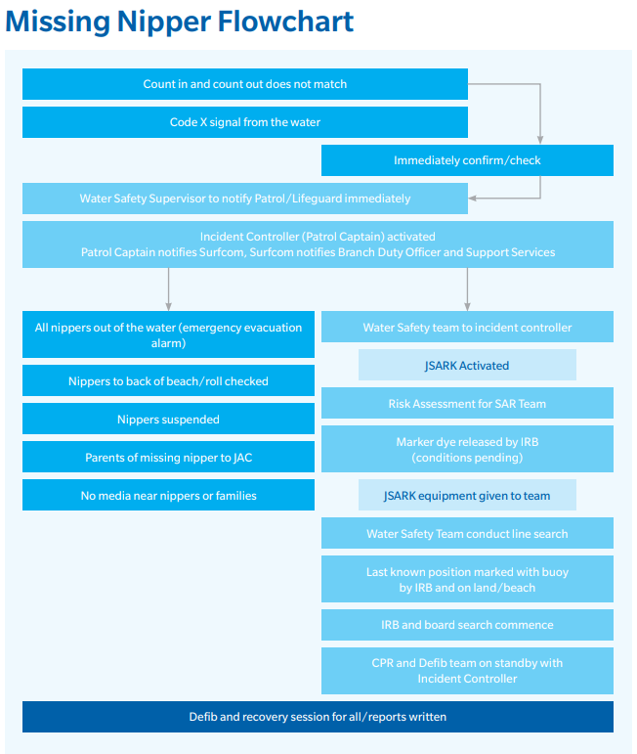
Junior Search and Rescue
Slide need to be tailored to your specific club requirements – there are some guidance notes included
Safety First: Clubs are be committed to providing the safest environment for all members, but emergencies can still occur.
Clear Command Structure: In an emergency, the Water Safety Supervisor (or coach at training) has command until a Patrol Captain, Lifeguard, or emergency authority arrives.
Rapid, Controlled Response: Immediate action is critical—delays can compromise safety.
Everyone Must Know the Plan: All Patrol Captains, patrol members and members on the beach during Nippers must understand search and rescue protocols.
Practice Makes Prepared: Emergency procedures must be tested annually with Patrol Captains and Water Safety Supervisors.
Support for Families: A well-practiced response builds trust and confidence among parents and guardians.
Notes:
How would our Patrol/Nipper team manage a missing nipper?
How would our Nipper team react - are your Patrols aware
Do we know how to manage this search and rescue?
Have we practiced this scenario? (Nipper parents are always impressed when they see this scenario being implemented)
Brings the Club together to deliver this - need Lifesaving team involved
Our search and rescue kit ready on the beach.
Do we know how to deliver a safe and rapid response to commence the search.
SLSNSW strives to provide the safest environment for all members participating in its activities, yet emergency situations can still occur. In these times, the highest priority is to focus on a rapid, controlled response to commence a search, or alleviate the situation.
When an emergency or major incident happens, the Water Safety Supervisor/Coach has command and control until either a Patrol Captain or Lifeguard (on patrolled beaches) is available or until an authority (e.g., police or Emergency services) is present and able to take command.
Every club (and everyone who could be on the beach during nippers) need to know how a search and rescue takes place during nippers. This needs to be practiced with Patrol Captains, Water Safety Supervisors at least one every season to ensure that your club is ready to act seamlessly.

Slide 26
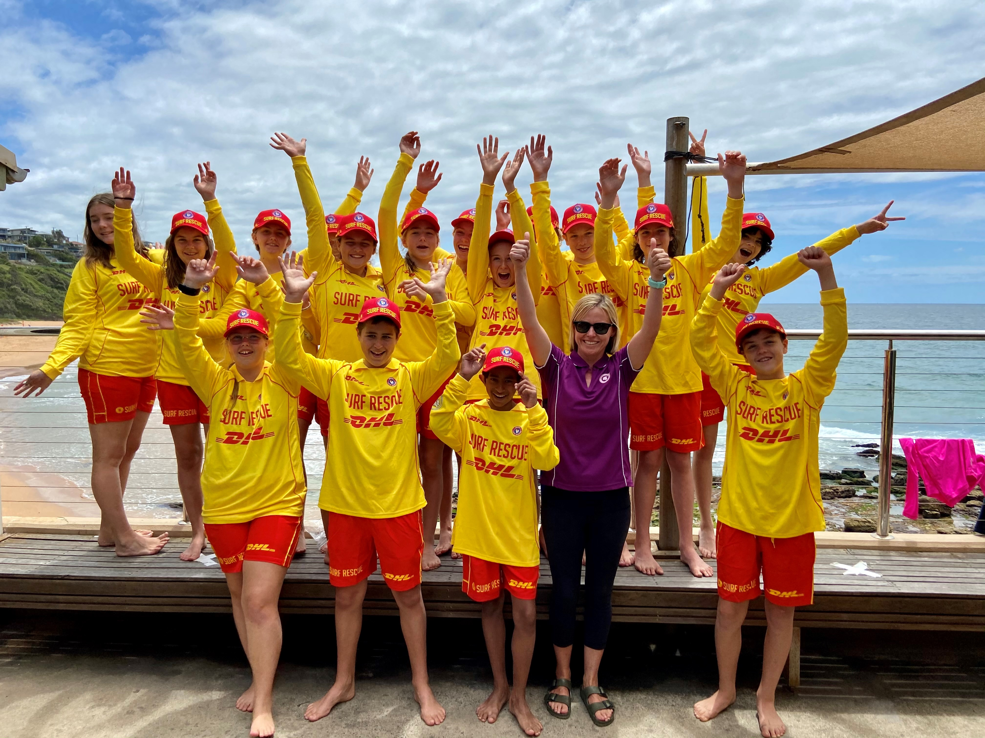
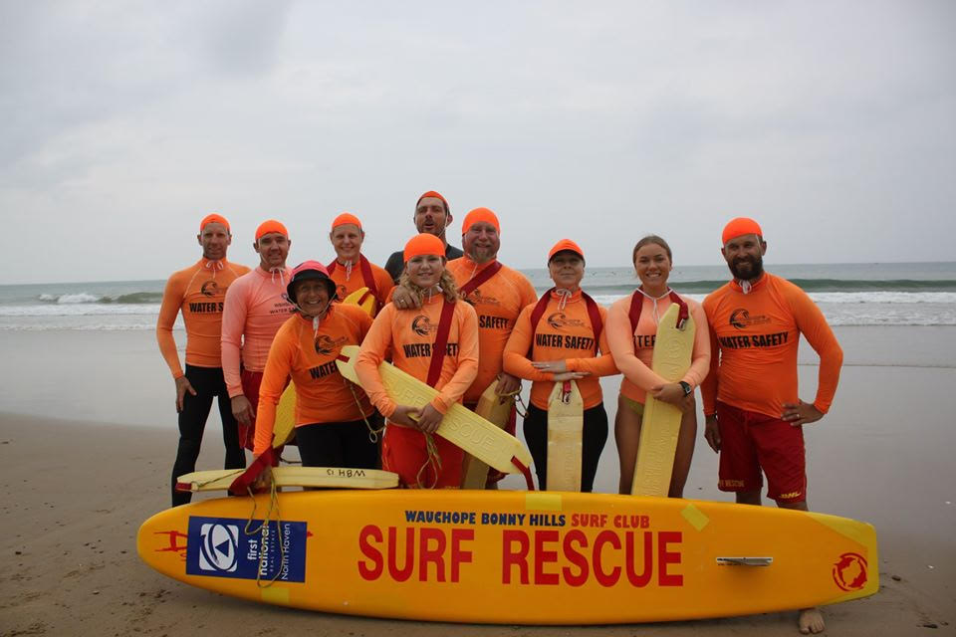
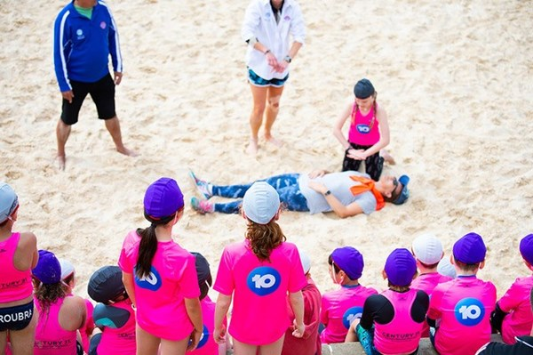
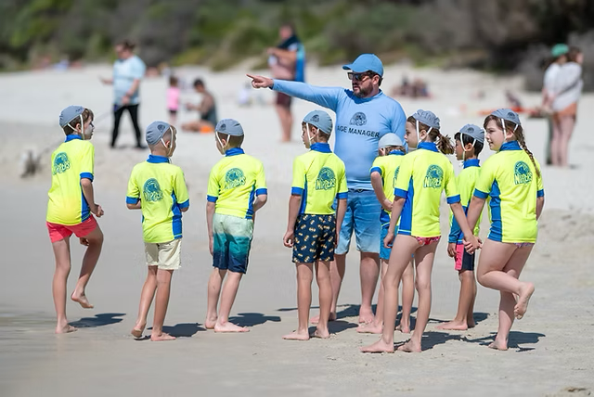
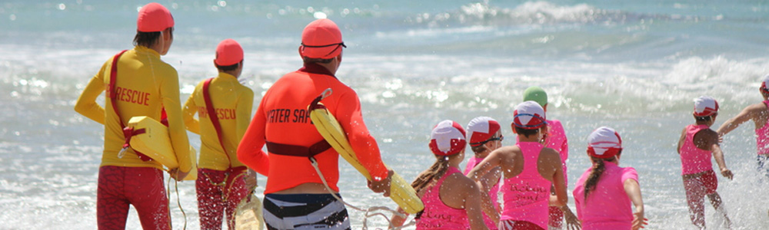
End screen - Your Club Nipper Imagery with your latest SRC Grads included showing the fun and friendship
Update with your club pictures and content

