Slide 1


Local SAREX Participant Refresher Presentation
This presentation has been developed for participants in a local SAREX.
It is intended to be delivered either right before the SAREX or online during the week prior.
Please feel free to skip over any content not relevant to your SAREX.
SAREX Toolkit

Slide 2
Topics
The presentation will cover the following topics
Tasking Arrangements
SMS Notification – What it looks like
Radio communications
Search patterns
  Line search
  Creeping line
  Square
Tips for responders
  What to do if you're first on scene

Slide 3
Tasking Arrangements
Who we get tasked by (police
Our role (support combat agency)
Control, command, forward command, rescousce

Slide 4
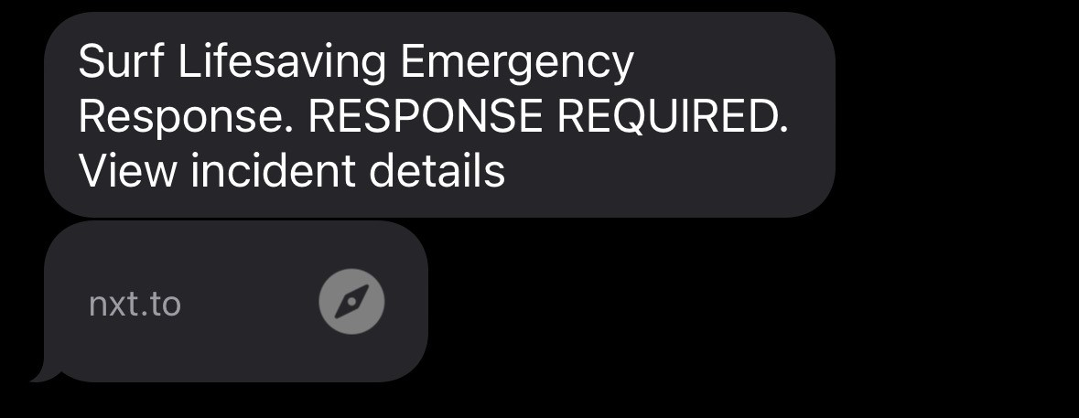
How you will be activated
Activations come via SMS from Surfcom to all members listed in the club ECOT list in surfguard. The text will come from this number – please put it in your contacts – and will look like the image below:
0400 717 042

Slide 5
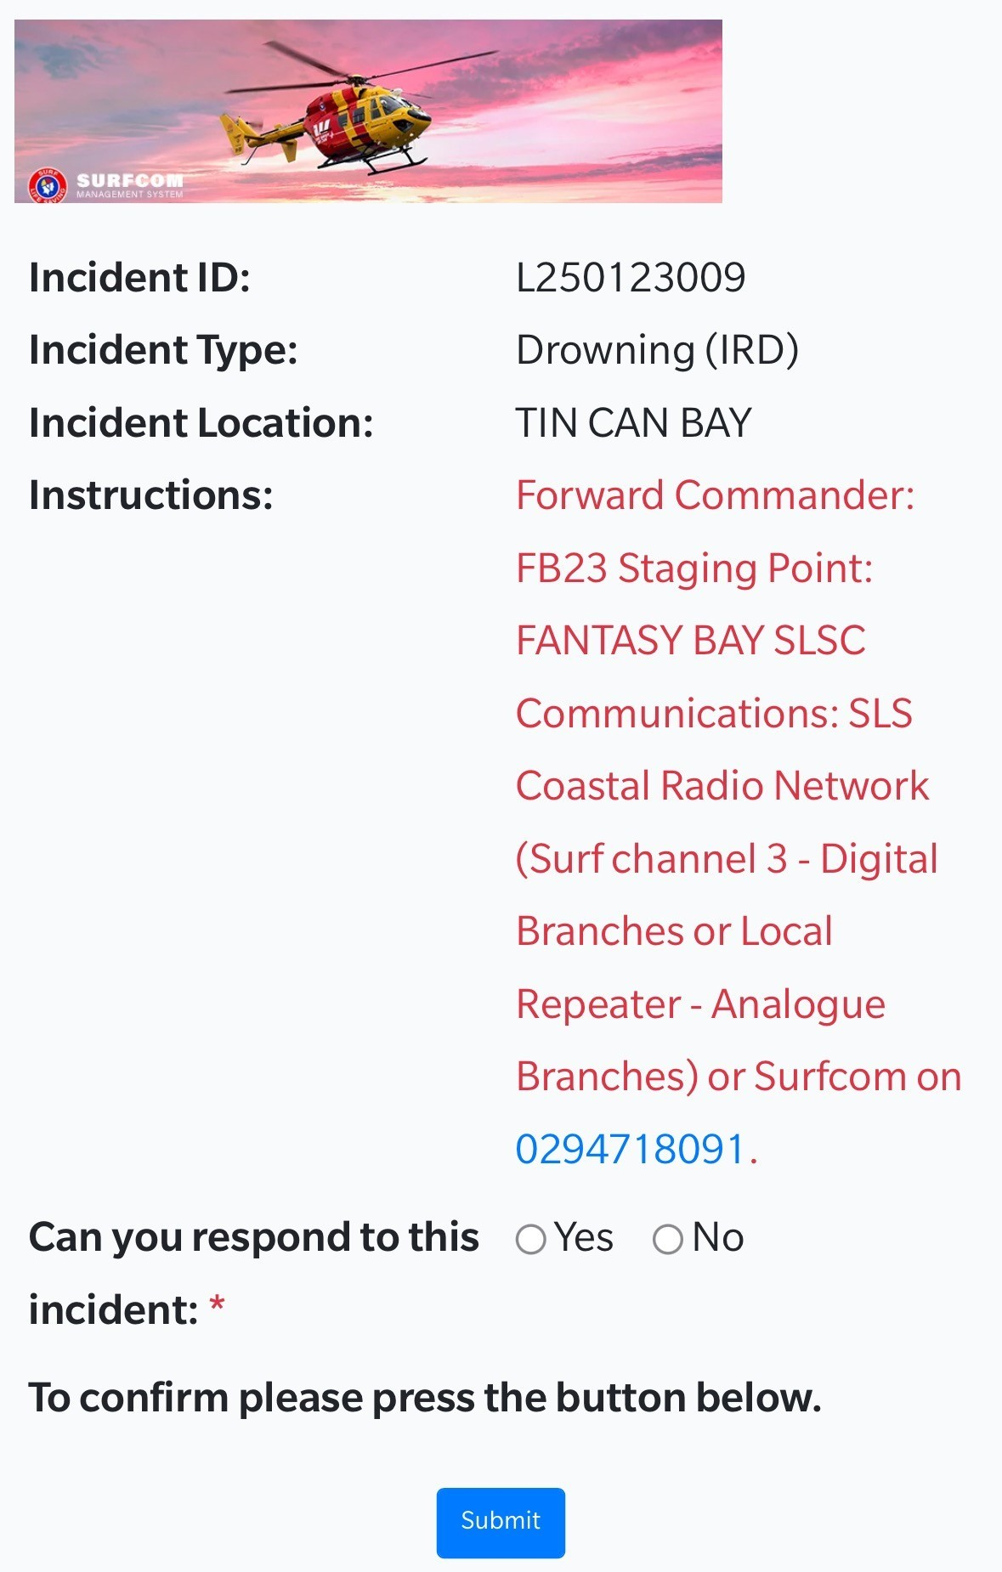
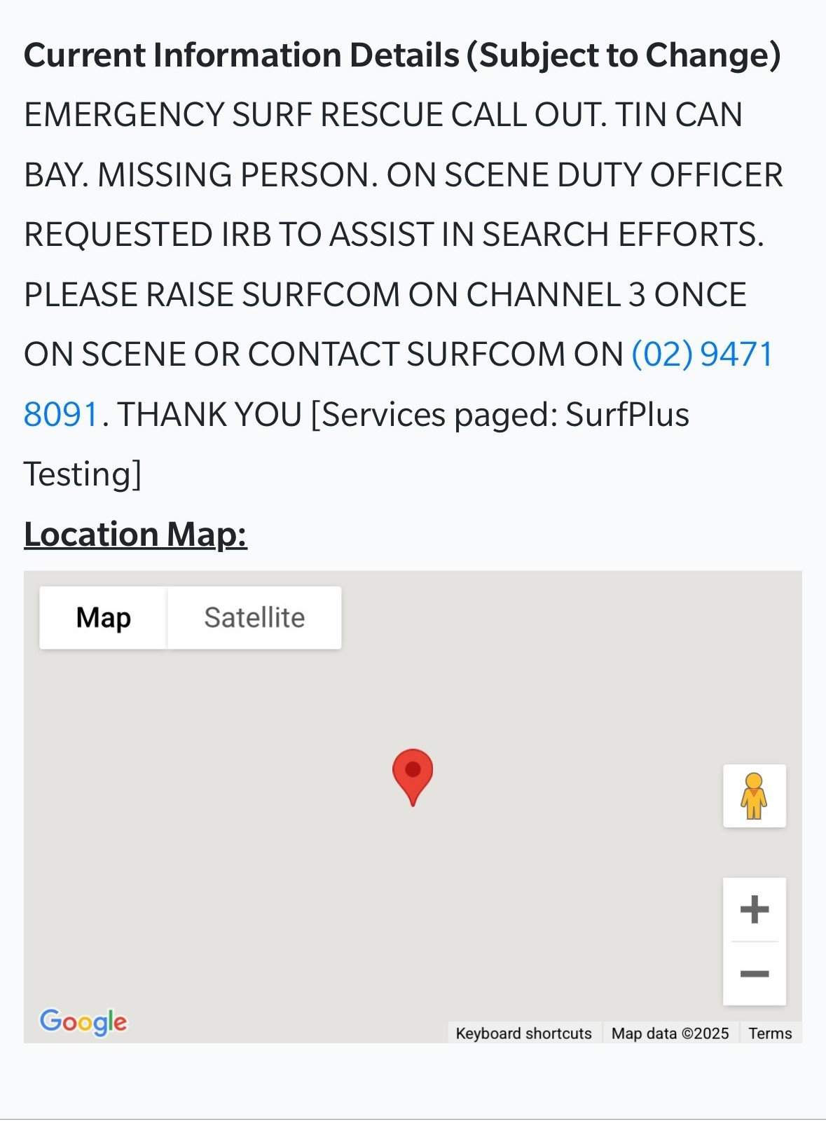
What you will see on your mobile

Slide 6
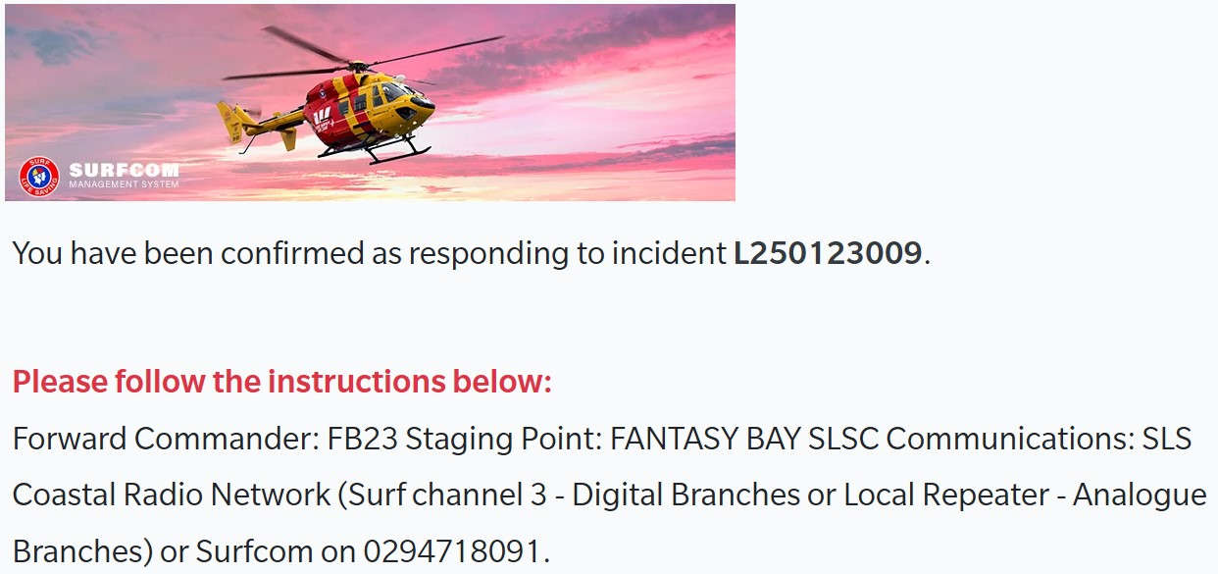
What you will see on your mobile

Slide 7
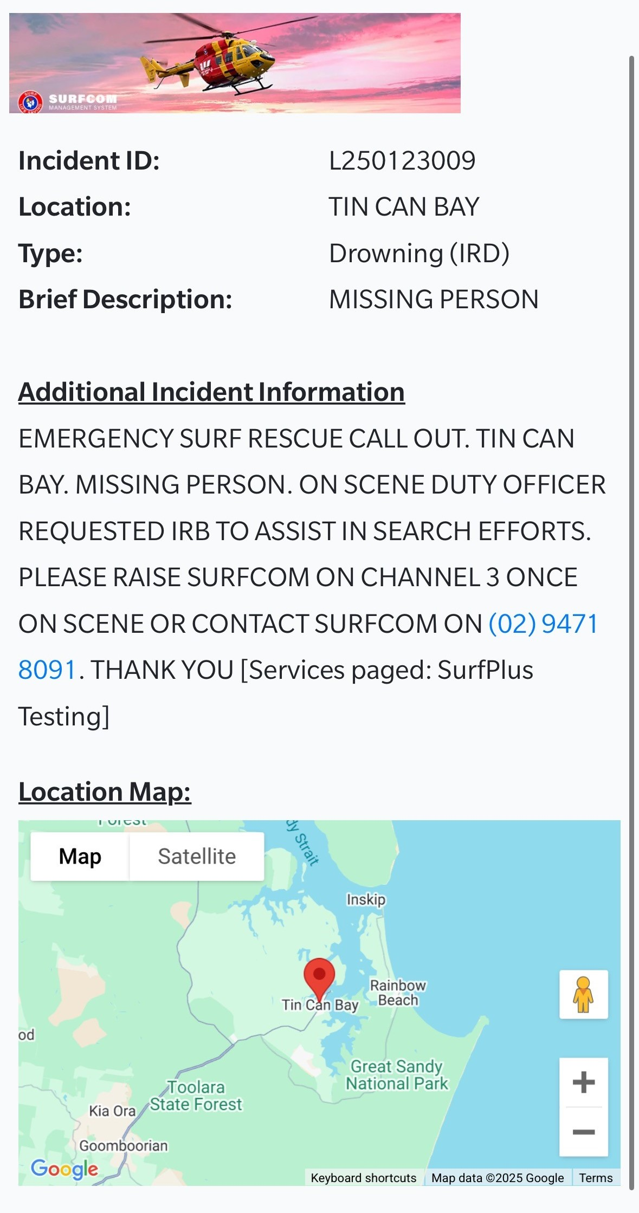
When additional info comes in

Slide 8
Radio Communications
When you arrive at the club and contact Surfcom to provide a SITREP you can follow the SAND acronym:
Patrol Comms – 4 P’s
Outside Flags – SITREP
P – Position
P – People
P – Problem
P – Progress
S – Situation
A – Actions
N – Needs
D – Decisions
Note: SAND is a tool to assist in providing a structured SITREP to SurfCom for outside the flags operations. This does not replace the 4P’s.

Slide 9
Radio Communications
Radio communications can be broken down into 3 groups. Arrival, Situational Report and Closing message.
Arrival – SAND. Initial message to SurfCom. Let's them know a member is on scene/at surf club.
SITREP – SAND. During the incident providing updates to SurfCom
Closing- Rescue Readiness. A message to SurfCom notifying that all assets are Rescue Ready, this includes our members.
Note: SAND is a tool to assist in providing a structured SITREP to SurfCom for outside the flags operations. This does not replace the 4P’s.

Slide 10
Search Pattens
For any water-based search to have a good chance of success, the search must be carried out in a methodical fashion, starting in the place where the missing person is most likely to be located and also ensuring it covers the area thoroughly.
Whichever search pattern is used, it must be suitable, feasible, acceptable and safe. The time, water conditions, wind drift and water currents will all influence decisions about which search pattern to use. Marking dye may also be used to help determine the water movement to assist in selecting the appropriate search pattern.
The distance between each leg of the search will depend upon these factors, with the guiding principle being to ensure the search area is visually covered.
The objective of surface searches is to look from above the water surface for submerged objects.

Slide 11
Line Search
Line search pattern, also known as parallel line search, involves team members moving in a straight line from the last know location in the direction of the wind or current. The distance between personnel participating will depend on factors including:
What gear and equipment they are using
The depth of the water
Sea conditions
Water clarity—the less clear the water, the closer together the searchers must be

Slide 12
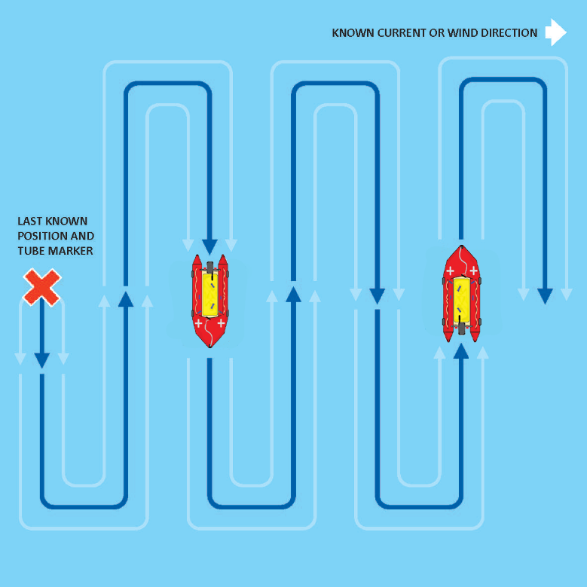
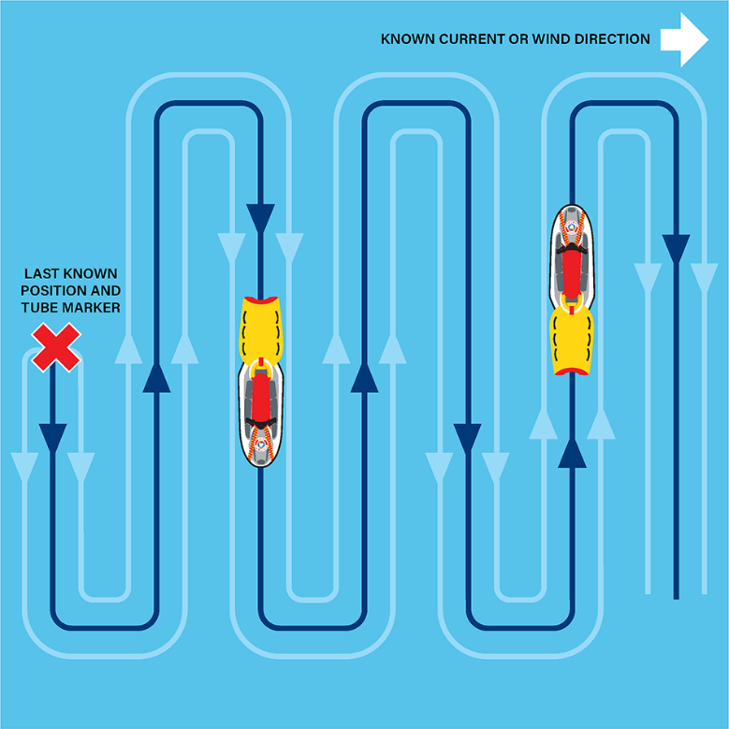
Line Search

Slide 13
Creeping Line
The creeping line search pattern involves moving back and forth in making gradual increments parallel to the previous track.
Starting from the last known location, the pattern will follow the measured direction of the current where the missing object or person is likely to have also drifted.

Slide 14
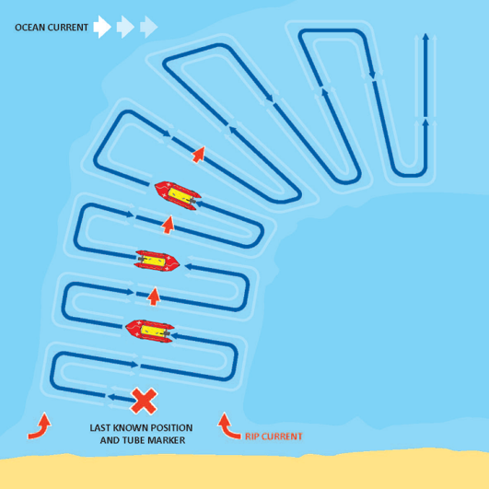
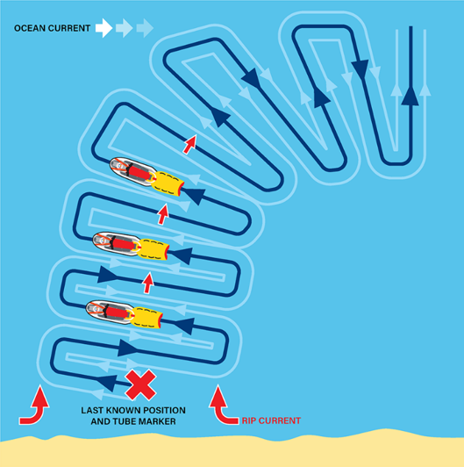
Creeping Line

Slide 15
Square
The square search pattern is often used by vessels (although can be used by swimmers) and involves the search starting from the last known location and moving outwards in a square pattern.
It is typically used where there is little ocean current or drift, or where it is highly likely the object has remained static.

Slide 16
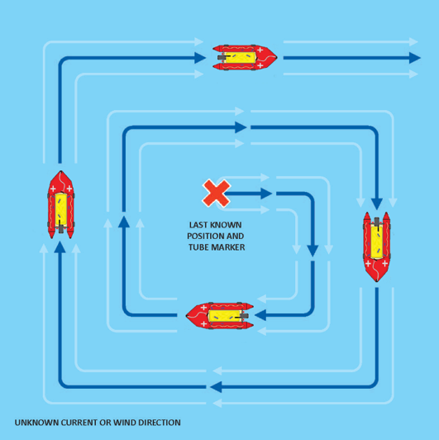
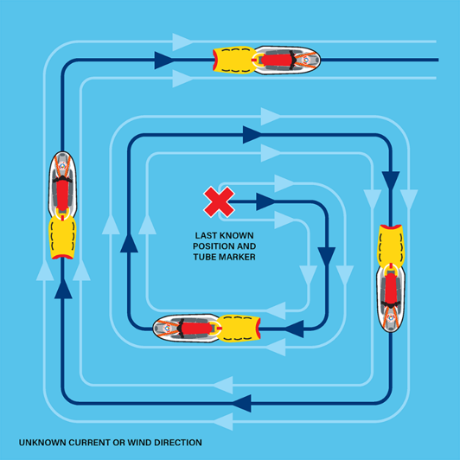
Square

Slide 17
Tips for Responders
What to do if you're first on scene
If there are members of the public/bystanders on scene
check in with them, to gather as much information as you can
Let the SOC know that you're on scene
Advise what the visibility and conditions are
What you observe
What the drift is from the last known point
Remember, when explaining wind and current direction: Wind blows from and current goes to

