Slide 1

Emergency Call Out Team (ECOT)
Annual Induction
[your club name]
ECOT Induction
Insert your
club logo
in this space

Slide 2
Your team
Name | Mobile | IRB | RWC | UAV | Medical | Comms | Logistics | Other
Full name | xxxx-xxx-xxx | x |  | x

Slide 3
Expectations for ECOT members
ECOT’s have a range of skill sets & experience levels but the following expectations are for everyone on the team:
Safety
Your safety & that of your teammates is your main priority – if you don’t feel safe in the conditions let your team leader know
Self-tasking
Never self-task – always contact Surfcom before responding to any emergency
Availability
No-one is expected to attend every call out, we just ask that you respond promptly to the Surfcom SMS with your availability YES or NO

Slide 4
Expectations for ECOT members
Responding
Drive safely & obey all road rules on the way to an incident
Professionalism
Model professional conduct & be mindful that family members of people in distress might be close to our operating environment
Risk assessments
Continue to conduct dynamic risk assessments &, if you notice any changes in conditions, communicate to your Forward Commander or SurfCom immediately

Slide 5
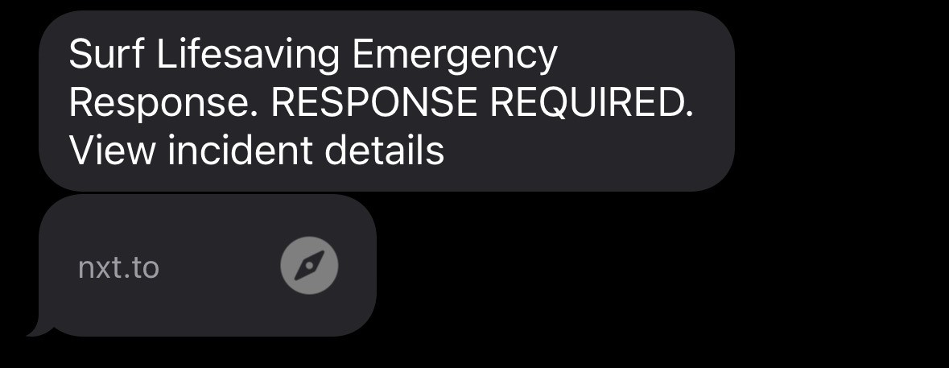
How you will be activated
ADD THIS NUMBER TO YOUR CONTACTS
0400 717 042
WE DO NOT SELF TASK OR ACTIVATE

Slide 6
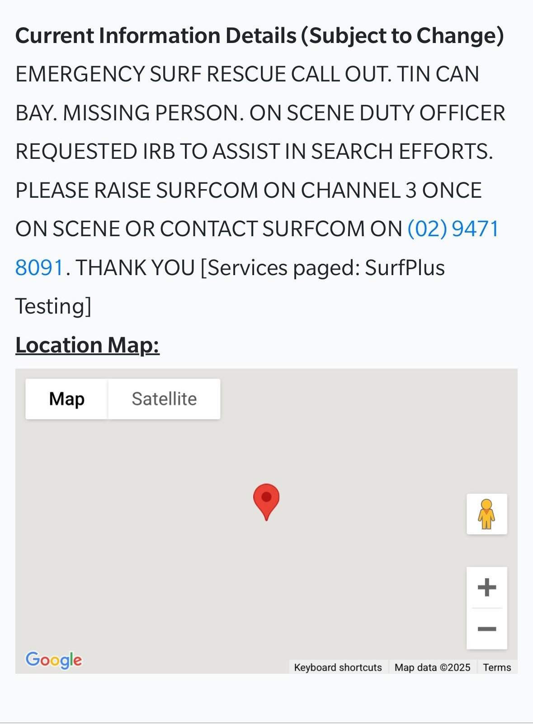
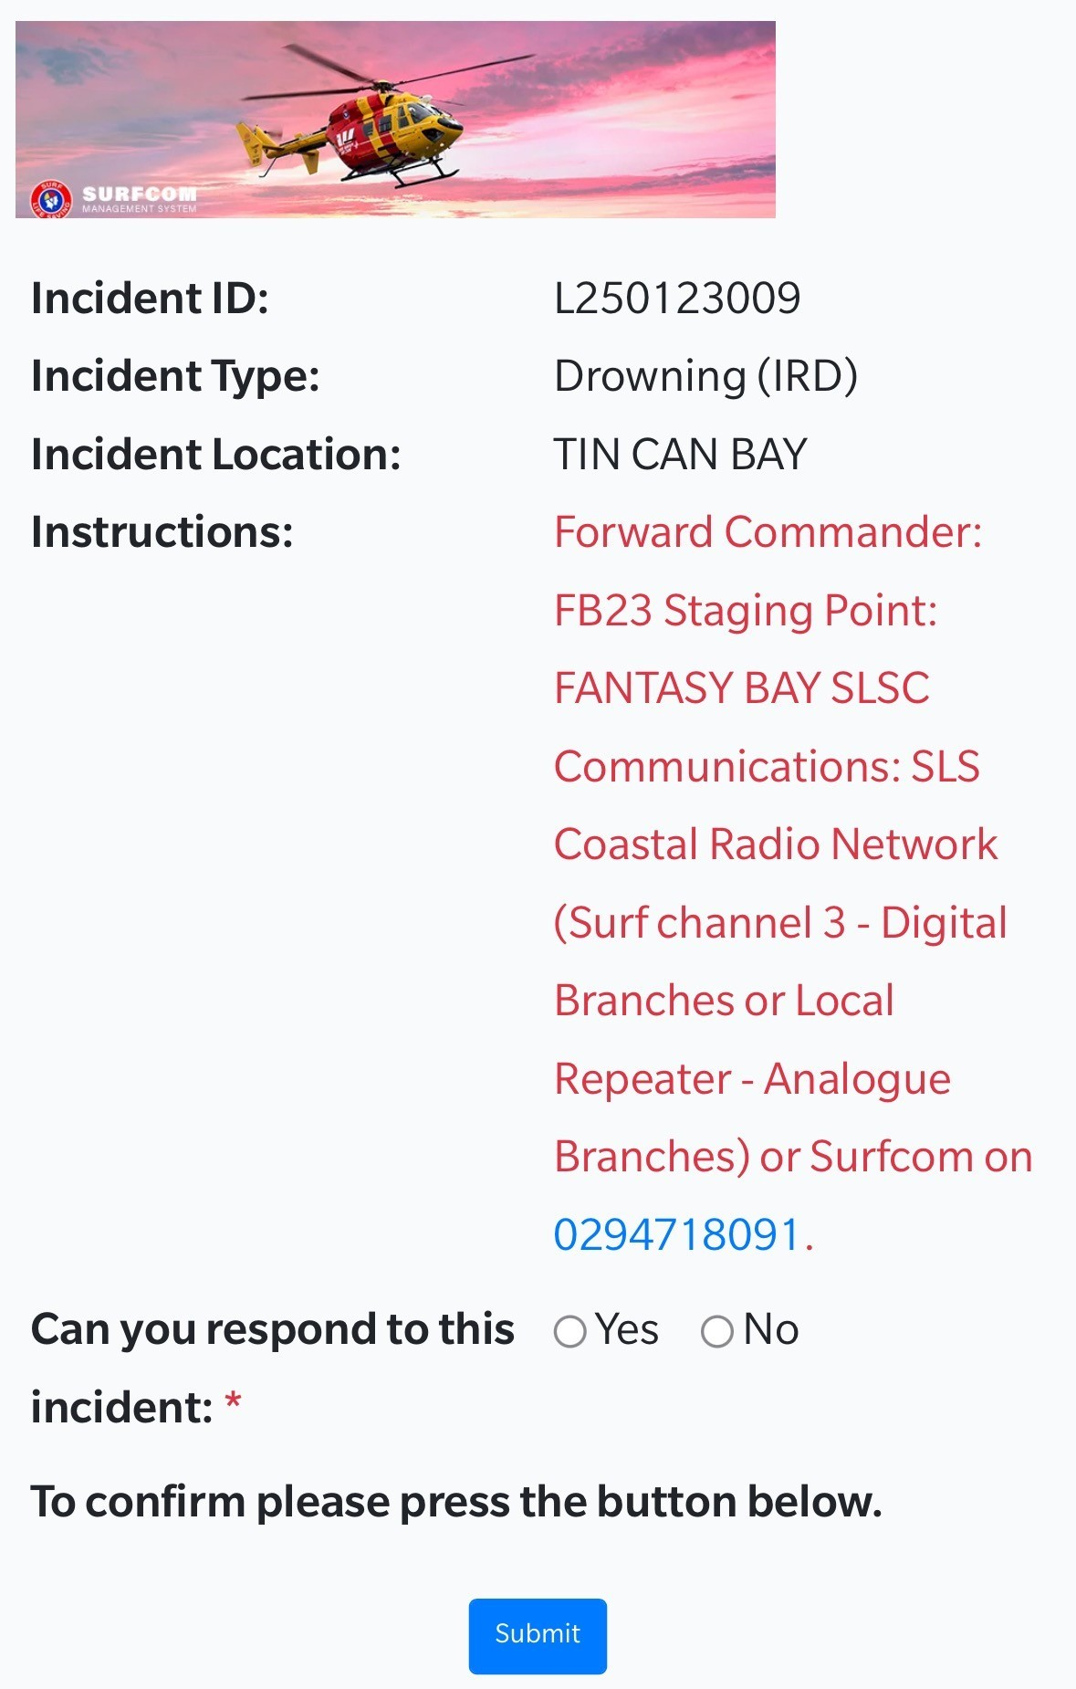
What you see on your phone

Slide 7
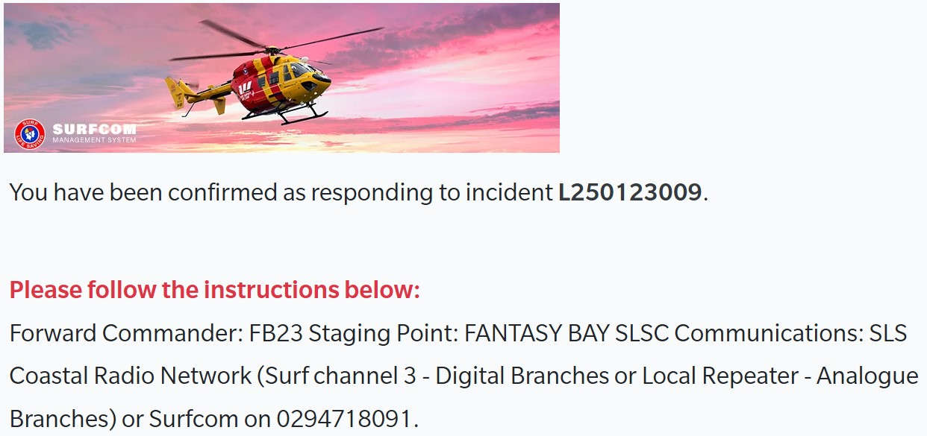
What you see on your phone

Slide 8
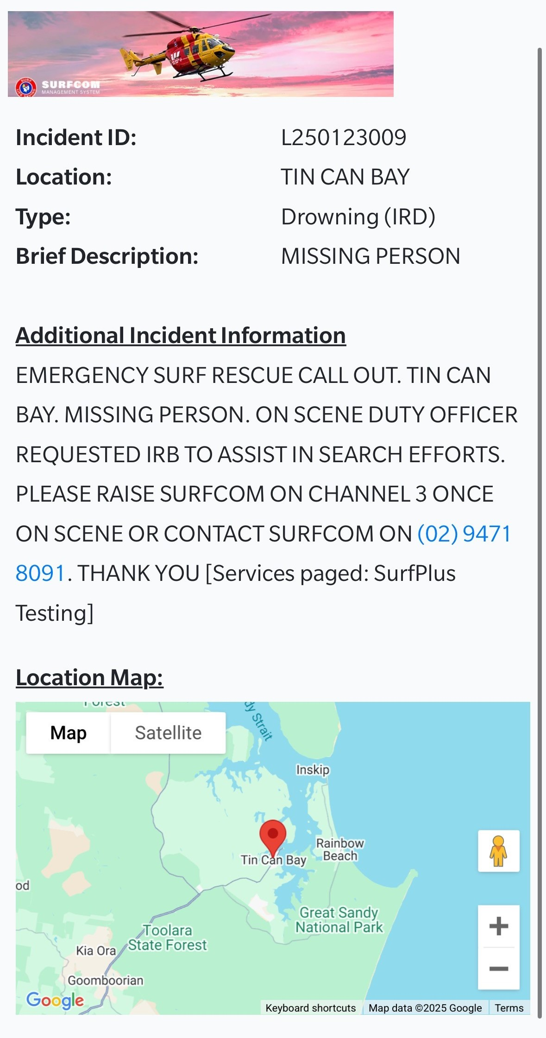
When additional info comes in

Slide 9
What is the State Operations Centre (SOC)
Central hub for SLSNSW emergency communications, coordination & operational support.
Coordinates resources to get the right response to the right place
Maintains the operational picture, tracking incidents, resources & critical information as situations develop & report back to Police.
Supports frontline teams before, during & after incidents, including escalation, coordination & incident reporting.

Slide 10
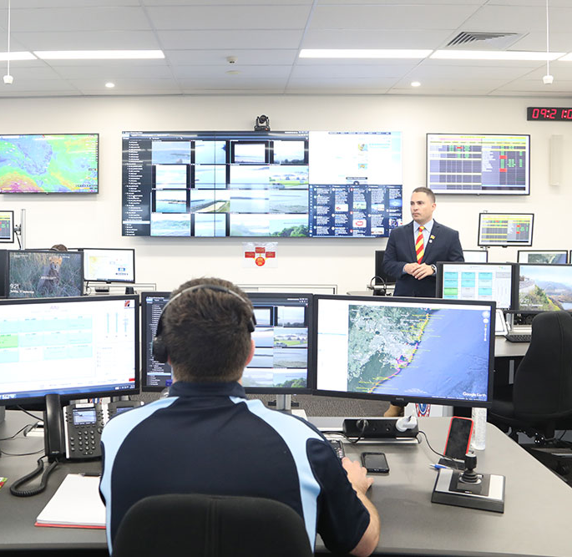
What is SurfCom?
Surfcom is our operational call sign & the function that receives emergency calls & coordinates responses.

Slide 11
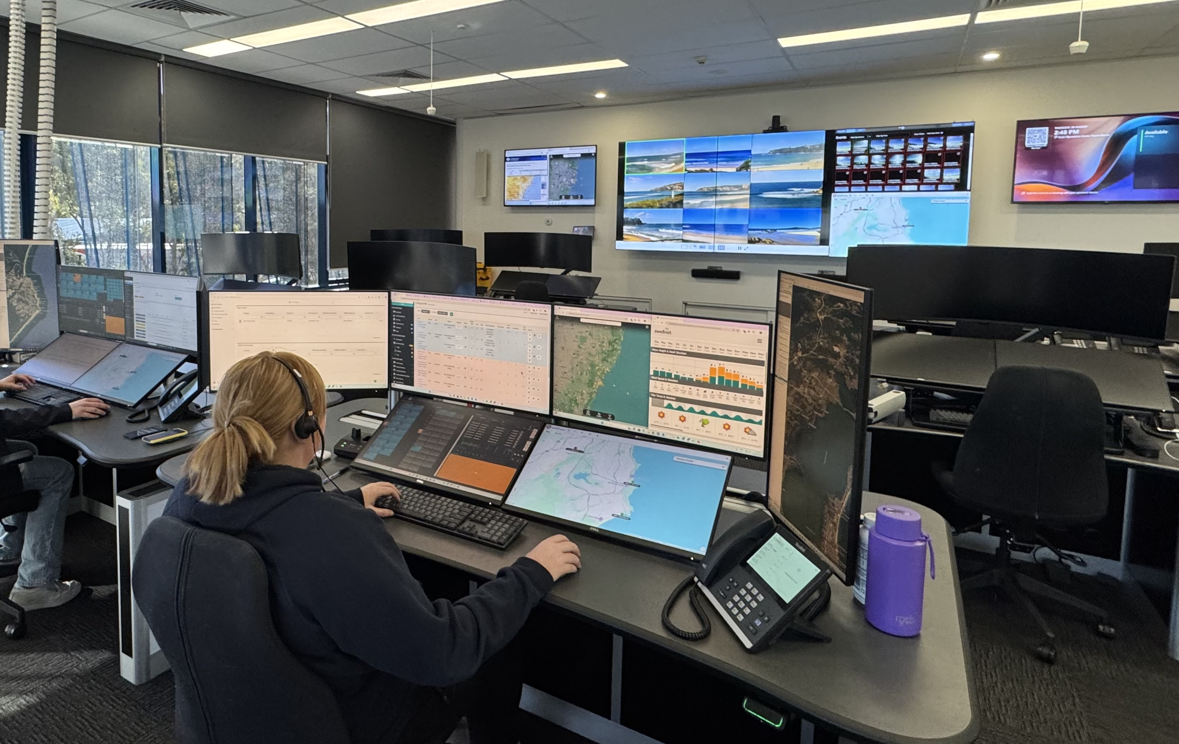
SOC – what it looks like & tools available
What's on the screens?
Omnicore – State Radio System
ICEMS
SurfCom Management System
Google Earth GIS
Flight monitoring & swell
Telematics GPS tracking
Surf Cameras
ERB Cameras
BoM weather
ABC News

Slide 12

What happens when a call comes in
NSW Police
Rescue Coordinator
ICEMS
Nearest, most appropriate
SLS asset
SOC/SurfCom

Slide 13
Radio etiquette
With more services using SurfCom there’s an increase in transmissions
Only use Channel 3 for communications that other clubs or SurfCom NEED to hear
When using the radios locally, ask yourself – should we push this to Channel 2
For example:
UAV at your beach advising patrol of a risk can use Channel 2
If beach closes due to shark activity this needs to be communicated on Channel 3
Keep transmissions short/concise & consider what channel is most appropriate

Slide 14
Radio communications
The first ECOT member to arrive at the club should contact the SOC on Channel 3 to provide a SITREP following the SAND acronym:
Patrol comms – 4 P’s
P – Position
P – People
P – Problem
P – Progress
Beyond the flags – SITREP
S – Situation
A – Actions
N – Needs
D – Decisions
Note: SAND is a tool to assist in providing a structured SITREP to SurfCom for beyond the flags operations. This does not replace the 4Ps on patrol.

Slide 15
Radio communications
Radio communications can be broken into 3 groups. Arrival, Situational Report & Closing message.
Arrival – SAND. Initial message to SurfCom. Let's them know a member is on scene/at surf club.
SITREP – SAND. During the incident providing updates to SurfCom
Closing- Rescue Readiness. A message to SurfCom notifying that all assets are Rescue Ready, this includes our members.
Note: SAND is a tool to assist in providing a structured SITREP to SurfCom for outside the flags operations. This does not replace the 4P’s.

Slide 16
Secondary communications
Use this page to let your members know of any secondary forms of communication for your team such as Whats App or Messenger groups. Please make sure you reiterate that this group doesn’t replace the initial response and comms with SurfCom.
Enter text
Enter text
Enter text
Enter text
Enter text

Slide 17
What to do when you arrive at the club
The first person to arrive at the clubhouse should:
Turn a radio to Channel 3 & contact SurfCom &/or the Forward Commander (who will be on the same channel)
Provide a Situation Report (SITREP) letting them know you’re at the club & requesting any additional information available.
Note: there is often very limited information available in the early stages. SurfCom is not holding out on you & they’ll get you information as soon as they have it.

Slide 18
Next steps in a call out
Enter a step-by-step procedure based on your club approach. It could include things like:
Open doors/roller doors
Hook up IRB to SSV
Place radios in waterproof pouches in each IRB
Ensure drivers & crew have PFDs available
Check inflation of IRB buoyancy tubes
Check IRB fuel cell is full & additional fuel is available
Based on available info prepare other equipment (first aid kit, defib, etc) that may be required
Start motor before leaving the club in case a switch is required
etc
etc

Slide 19
Chain of command
A Branch Duty Officer/ALS Lifeguard Supervisor (in areas where they operate) will be tasked to attend & they’ll become Forward Commander once on scene.
Until they arrive on scene the most appropriate senior/experienced member of your ECOT will take command of the response & should stay in close communication with SurfCom who can provide support.
Note that the Forward Commander may not be from your club but your ECOT still reports to that person.
The State Duty Officer in the SOC will retain overall responsibility for coordination of the incident & liaises with the Incident Controller – NSW Police in most cases.

Slide 20
ECOT equipment
All normal patrol equipment should be accessible & rescue ready for your ECOT. Specific items include:
  IRB/RWC (including relevant PPE/PPC, ie. PFDs, helmets, etc.)
  SSV/ATV
  Rescue Tubes & fins
  Rescue Boards
  Oxygen Resuscitation Kit
  AED
  First Aid Kit
  Radios
Discuss with your ECOT where these items are located.

Slide 21
Staying rescue ready
Use this page to outline how your club stays rescue ready. This could include things like:
ECOT Members
Keep handy items in your car if possible:
  Swimmers/wetsuit
  Towel
  Patrol uniform
  Enclosed shoes
  Sun protection
Equipment
Ensure primary call out IRB is always inflated and fully-fuelled
Radios always on charge (if the light is flashing red it’s not charging)
Highlight designated ECOT area/equipment if you have it at your club

Slide 22
Standing down
Instructions to stand down will come from Surfcom, either directly or through your Forward Commander/Duty Officer (note that Surfcom will receive a stand down from Marine Area Command and we can’t stand down on instruction from local police)
Once stood down all equipment needs to be cleaned, refuelled, recharged or otherwise returned to a rescue ready state

Slide 23

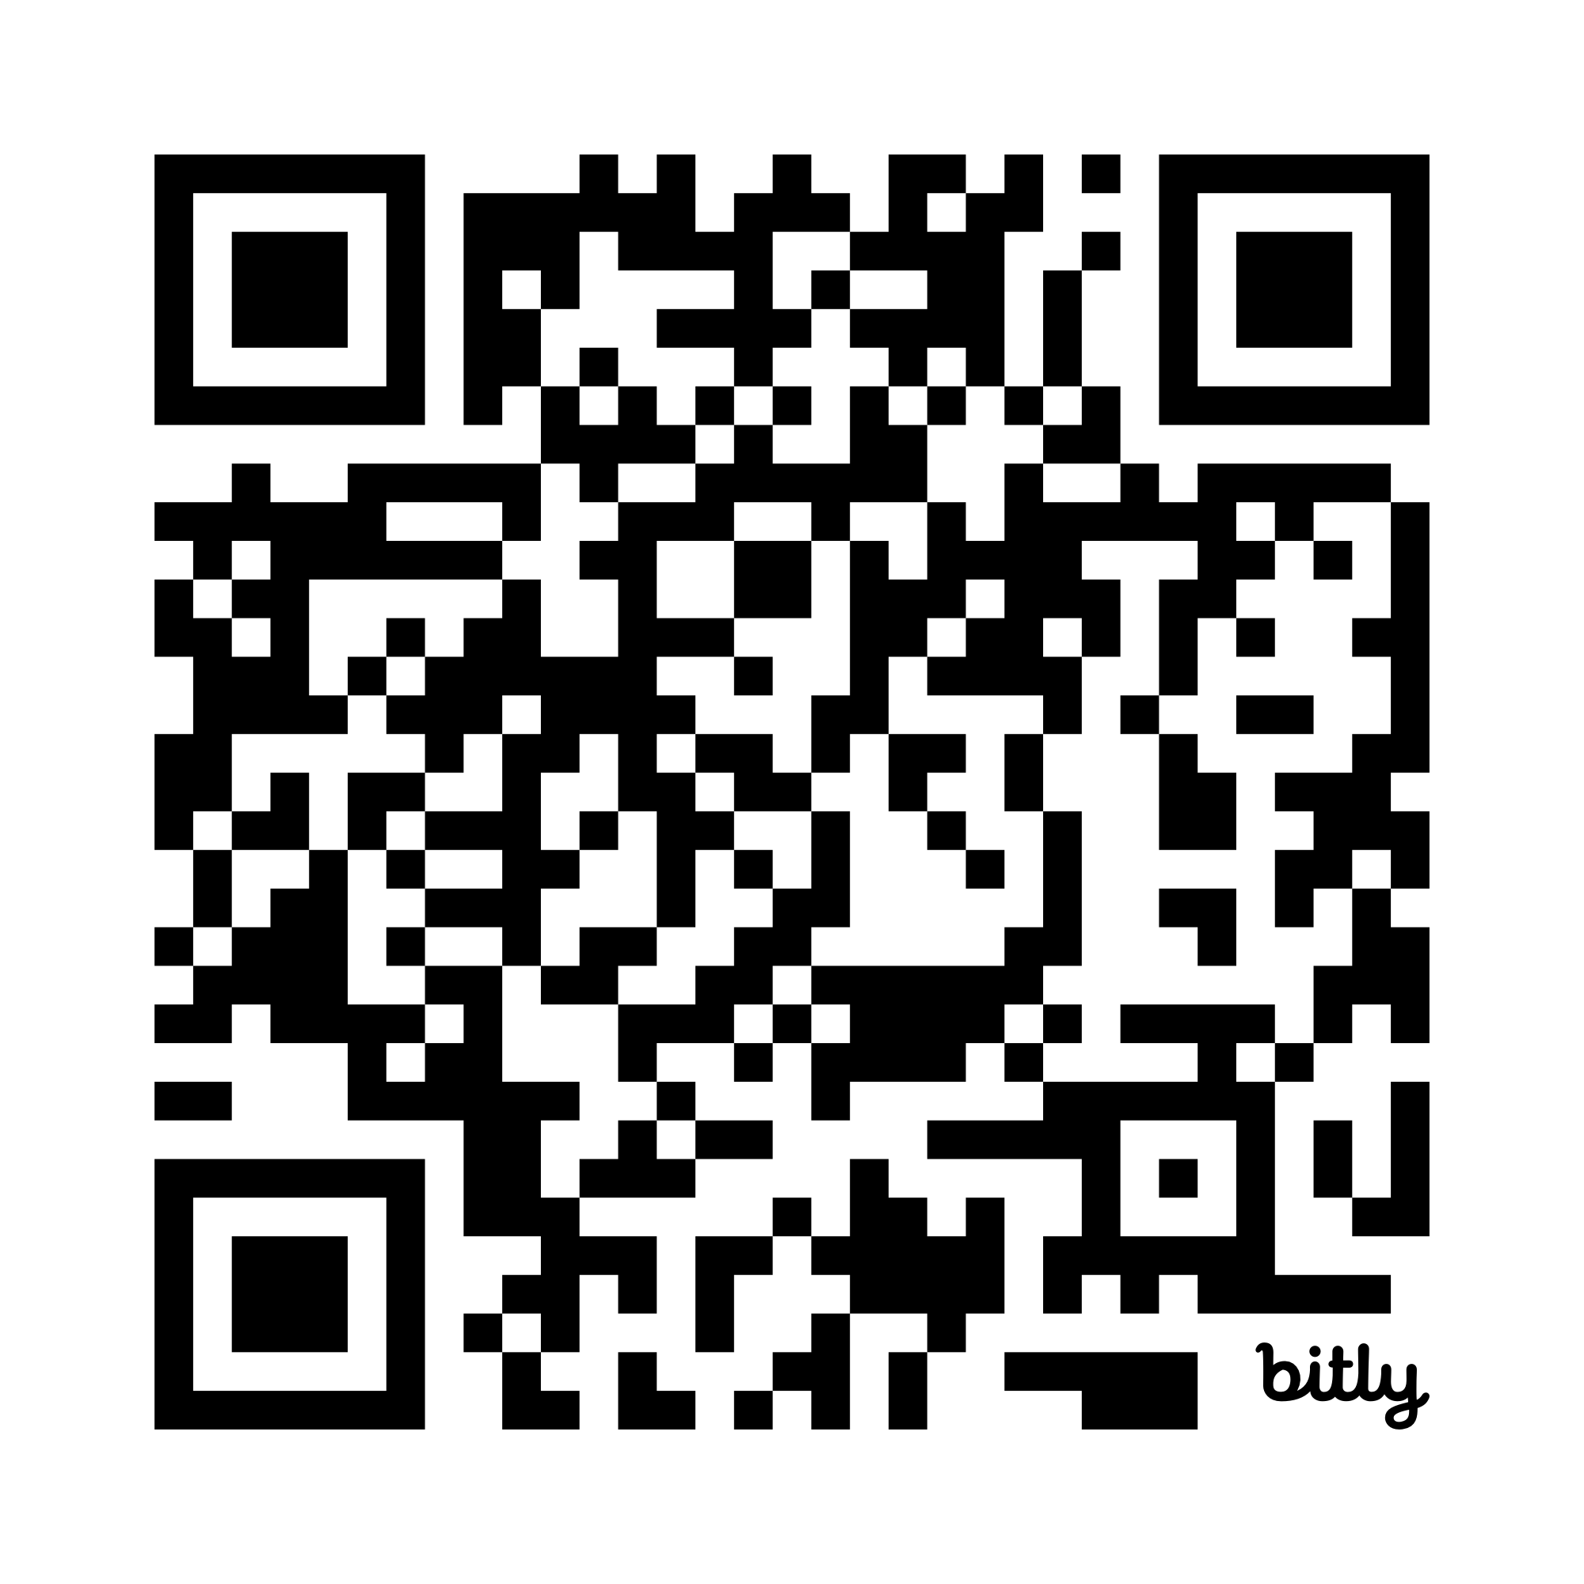
Operational debrief
There are two main types of debrief at SLSNSW:
Operational Debrief:
held immediately following an emergency response
conducted by your Forward Commander or ECOT leader
open to all personnel who respond to an incident
Critical Incident After Action Review (AAR):
ideally held within one month of an incident
conducted by a qualified person not involved in the response
  held to further unpack Ops Debrief feedback or seek/provide greater context
Both identify what we did well & what we can do differently. They are run on a “no blame” basis & ensure we learn from experiences & continually strengthen emergency responses.

Slide 24
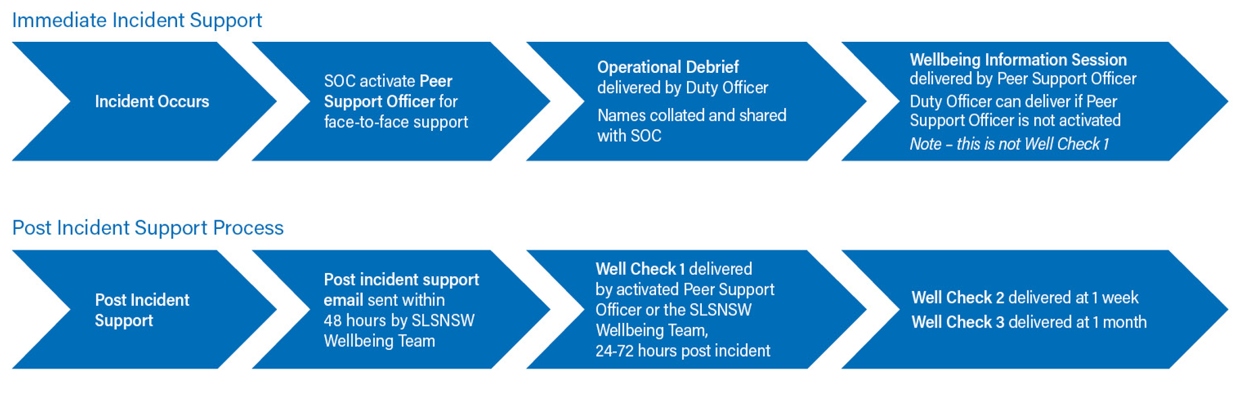
Member wellbeing
There is a high chance that members involved in search & rescue operations beyond
the flags may be exposed to confronting & potentially traumatic scenes &/or tasks.
Looking after our members is an important part of being on an ECOT:

Slide 25
Member wellbeing
Not everyone is affected in the same way. Some people have little, or no reaction. Others may experience some stronger reactions.
The SLSNSW Member Assistance Program provides free, confidential & professional counselling to members. No referral is needed to access this service.
Support is available to members for concerns or issues arising from their involvement in surf lifesaving, such as being involved in a critical incident or a club grievance.
Appointments can be made via multiple channels
Phone: 1300 687 327 / instant online booking / Live chat
SLSNSW Organisation Code (for online/App) is: SLSNSW

Slide 26
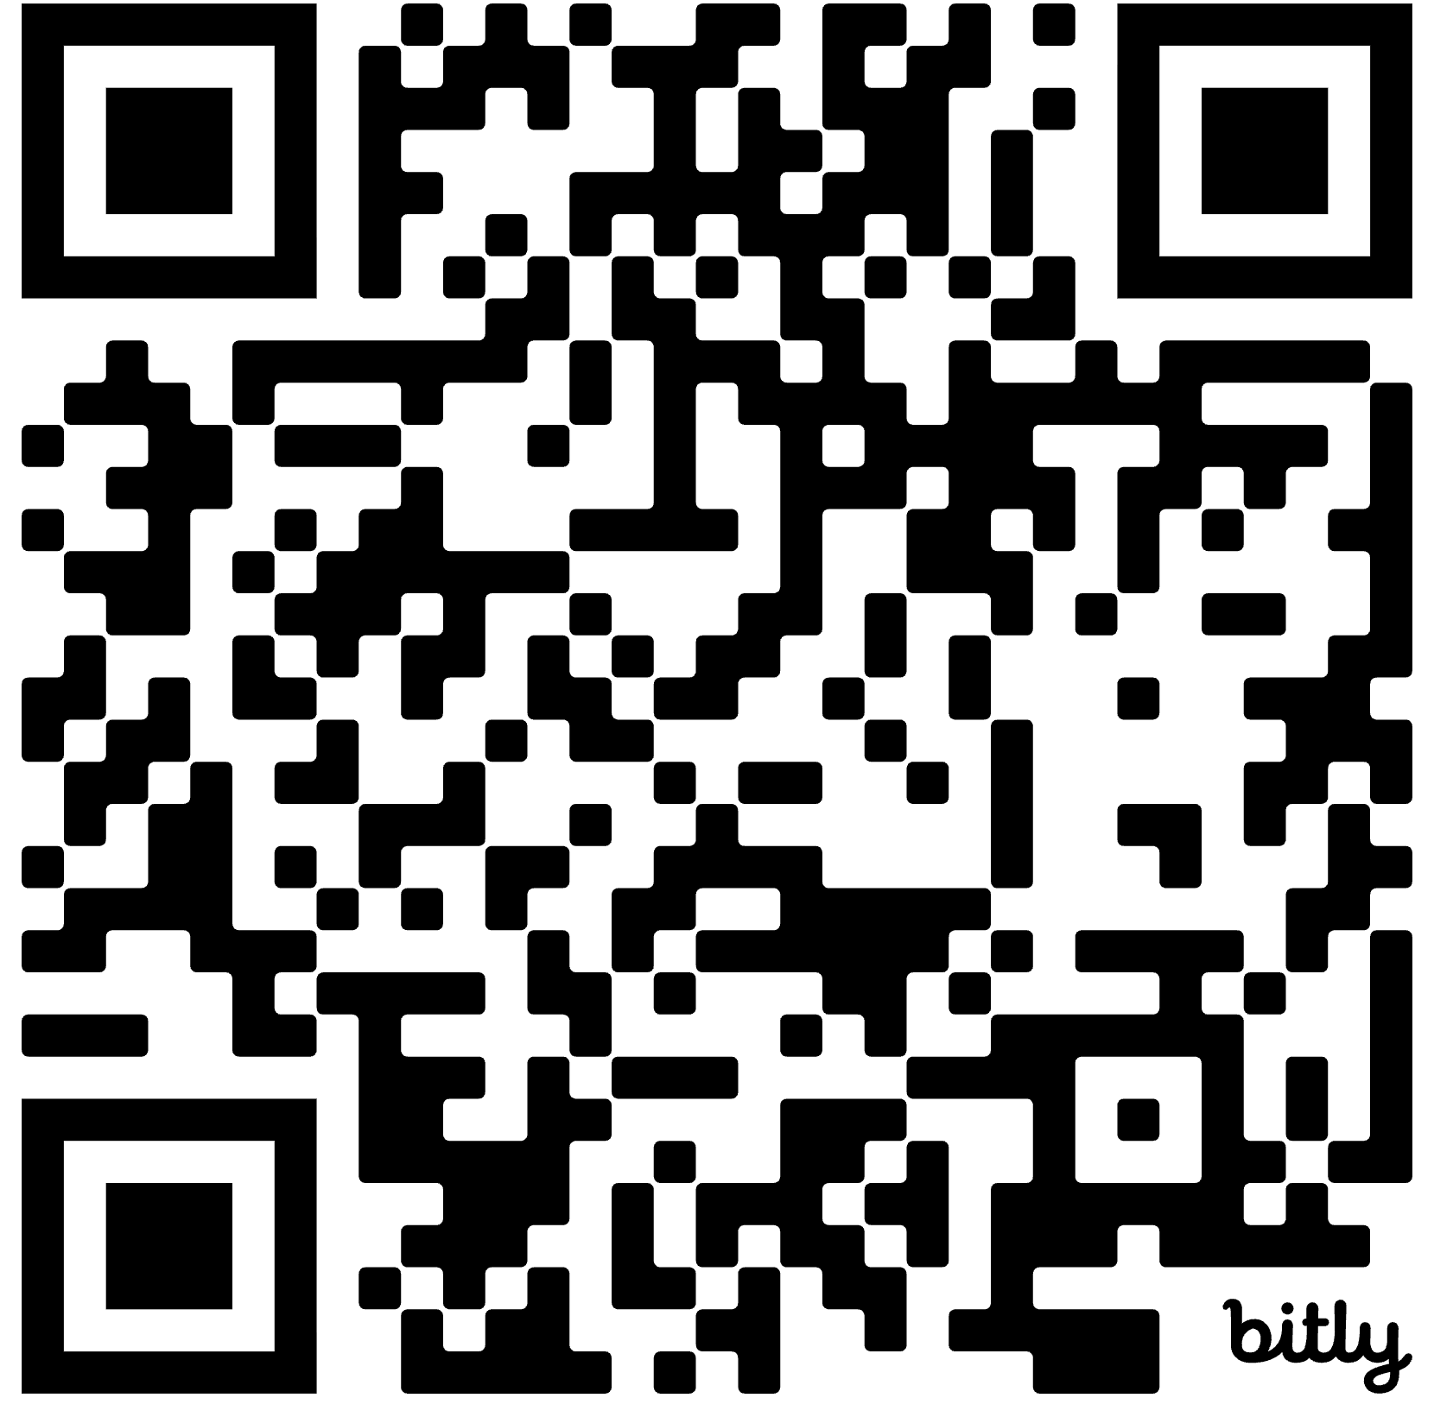
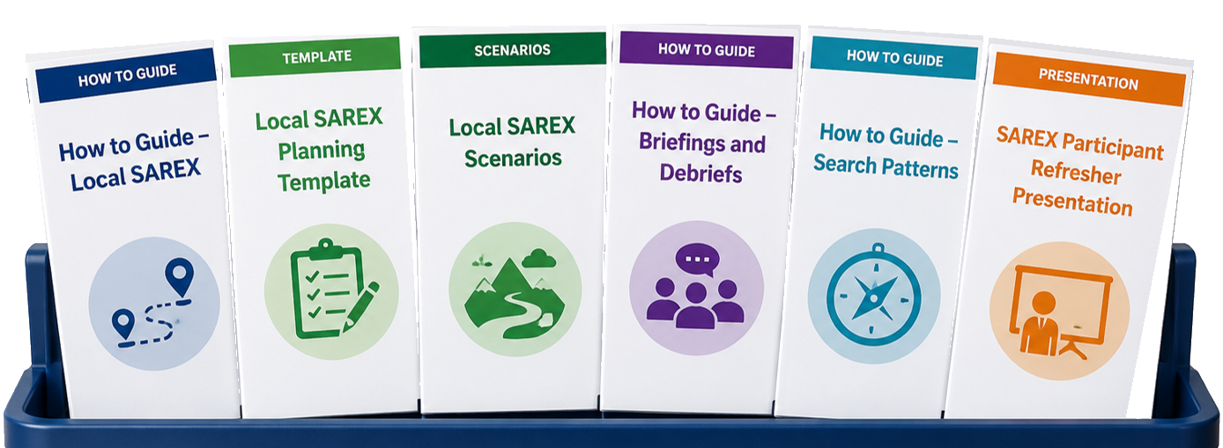
Search & rescue exercise
Use this slide if you are planning to run a live exercise (SAREX) or a desktop exercise (SARDEX).
You can find SAREX planning resources in the toolkit

